Slide 1
Senior Seminar
CS 4900 Group 2
Prop Hop
Week 5
Wallace Coleman
Allen Kubinski Jenna Schott
Notes:
PROPHOP!!!!!!!!

Slide 2
Performance
http://chandlerprall.github.io/Physijs/examples/shapes.html
Notes:
Jenna: This week I was trying to research the performance of WebGL and going forward each time it renders.
As we have mentioned in previous weeks, our game is very object heavy.
Example by Chandler Prall
We are trying to take a look at all options for implementing things moving forward because we don’t want to run into problems later.
Because of game is a puzzle game, there will be certain ways that we need to check to see if an object is at a certain location, and we were considering the best way to do that.
This week I spent a lot of time experimenting with Event Handlers to detect objects and how they interact.

Slide 3
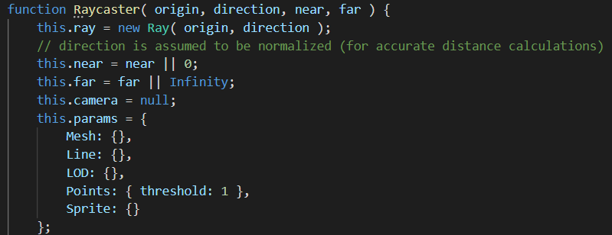
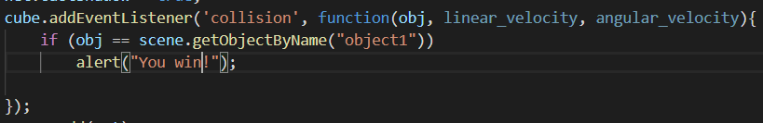
WebGL
Optimize performance - Event Handler
Raycaster versus Collision Detection
Notes:
I was researching the best ways to check our scene for certain objects to be in certain locations.
You can do a raycaster which is a type of event handler, to point towards a location and to see if an object is there or not.
The problem is, every time that we render the scene, the raycasting has to do 3 calculations every time that we render. Currently, we are using a raycaster that changes its position every render (Wallace will talk about that later), but we also don’t want to make a bunch of raycasters everywhere to check for objects all of the time.
The other event handler is to implement a collision detection when you create the object that you are watching for. I thought this would be a better use of performance space because it seems like the EventListener would have been a better choice because you don’t really need to deal with it after you create the 3D object. Additionally, you can determine how it will respond once it detects a collision, or you can also specify what to do with certain objects as well.
I thought the second option, the collision detection would be particularly useful for a puzzle, such as matching certain objects and only triggering a successful completion when the object matching is correct.

Slide 4

Solution: Physijs
Notes:
But I was talking about this with my group and with the way we have this set up, we likely don’t need to use either of these event handlers.
The way we have this coded, the player is whatever object they click on. The camera and physics are constantly calculating where you, the object is. Because it is always calculating our coordinates, it would be redundant to always be checking if we are hitting objects or reaching certain destinations, since we are already updating that information.

Slide 5
Jumping
It’s a thing that we have now
Notes:
So we were having a time implementing jumping. Our first attempts were based on the collision detection of physijs, however this allowed you to jump when you were touching anything, including the walls or ceiling.
Next we tried making sure the object you were colliding with was beneath you, however that approach allowed you to climb walls if you were able to jump up the the halfway point, so you were still technically above them.
We tried some complex math to figure out the height you needed to be at based on the rotation of the object, but then it we suddenly realized we were stupid, and we switched over to using a raycaster to determine if you were on top of something.

Slide 6
jumpCaster
let jumpCaster = new THREE.Raycaster();
jumpCaster.far = 3.5;
jumpCaster.set(new THREE.Vector3(0,0,0), new THREE.Vector3(0,-1,0));
jumpCaster.far = (scene.getObjectById(player).geometry.parameters.height/2) + dr;
Notes:
We created a raycaster called jumpCaster that points straight down, and set it’s far distance to be half of the height of the object plus a small amount, that the dr you see there.
The reason it’s a little more than half the height is so that we can place it at the center of the object and have it intersect things just below the object.
With this approach there is no need to check if there is a collision as the raycaster can handle all the detection

Slide 7
Level Selection (Two Steps Forward)
We can now load in levels from a separate javascript file using an OOP approach
Notes:
We created a Levels class that allows us to easily access to all of our levels, how many objects need to be loaded for that level, and some other basic info about the level.

Slide 8
Memory Leak (One Step Back)
let scene = new Physijs.Scene;
Notes:
This line was in an unfortunate spot that caused us to have a memory leak.
Our level select caused this leak because whenever we started to build a new level this line would execute.
The original logic was, “okay we’re throwing out the reference to the old Physijs scene so the garbage collector should take care of it,” but no.
It took a good little while to figure out exactly where the problem was.

Slide 9
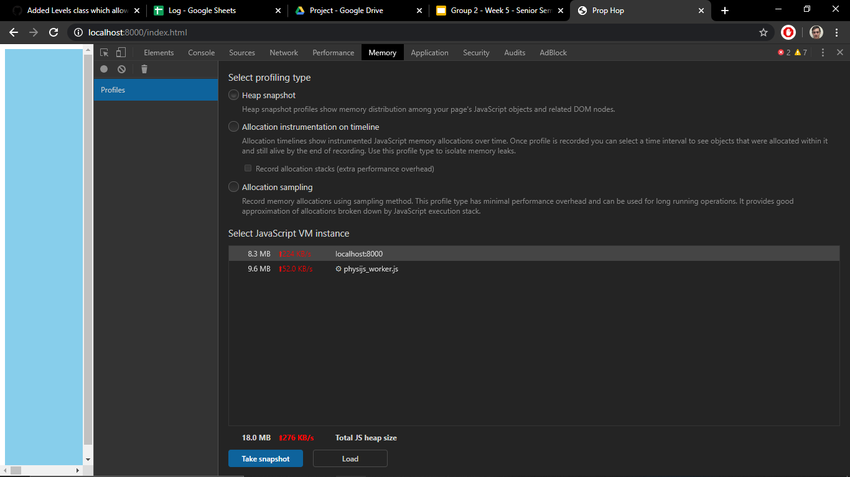
Notes:
The way we finally figured out exactly where the memory leak was, was by going to the memory tab of the developer tools
Here we noticed that every time the level was changed another phyisijs_worker.js appeared in this list, so we were able to figure out that the leak was from creating a new physijs scene everytime we changed levels

Slide 10
Solution to Memory Leak (Two Steps Forward)
while(this.scene.children.length > 0){
this.scene.remove(this.scene.children[0]);
}
Notes:
So our solution to the memory leak was to make a global scene and whenever a new level is loaded remove everything from that scene then start adding the new level’s content to the scene. Instead of creating a new instance of physijs.scene every time.

Slide 11
Model Loading (One Step Back)
Our models stop loading after we fixed the memory leak
Notes:
Long story short, we fixed the memory leak be making one global scene that is accessed using this.scene instead of always making a local scene. So everywhere we had scene needed to be changed to this.scene, no big deal right?
But then after that change suddenly our models weren’t showing up.

Slide 12
GLTF_loader.load('../../Models/Static_Models/Goal.glb',
function ( gltf ) {
let goal = gltf.scene;
this.scene.add(goal);
goal.position.x = 100;
goal.position.y = 10;
goal.rotation.y = .5*Math.PI;
goal.scale.set(10,10,10);
}
);
Notes:
So, in our loader we also switched from scene to this.scene, however, because this was inside the loader when it saw this.scene it thought that meant this GLTF_loader.scene which doesn’t exist, so we were getting this.scene is undefined in our console.

Slide 13
while(this.scene.children.length > 0){
this.scene.remove(this.scene.children[0]);
}
let scene = this.scene;
.
.
.
GLTF_loader.load('../../Models/Static_Models/Goal.glb',
function ( gltf ) {
let goal = gltf.scene;
scene.add(goal);
Notes:
We fixed this by making a local reference to this.scene and changing all the instances of this.scene back to just scene.
This cleared the issue up and now we can load our objects again

